Slide 1
IoT Workshop -1
by Atharva Pawar

Slide 2
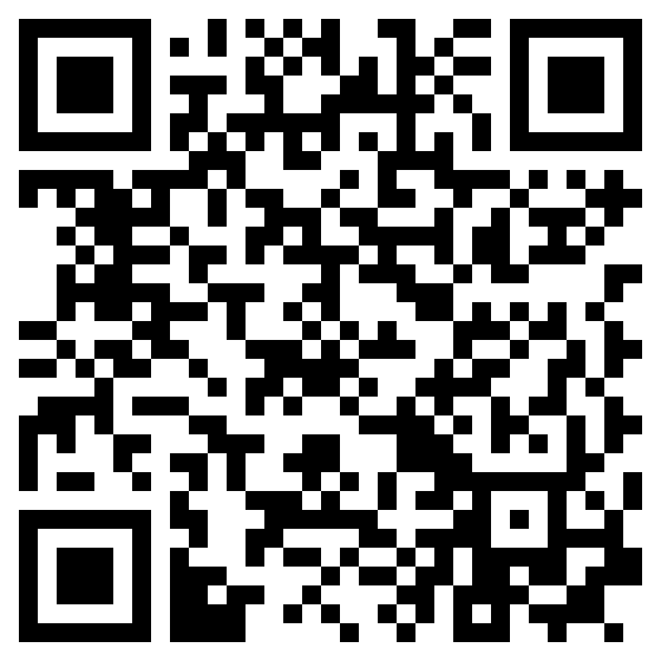
Index
Basic Interfacing
Database Connection (Thingspeak)
Esp32 Pinouts
IoT Workshop -1 (Atharva Pawar)

Slide 3
Interfacing:
Basic Electronics:
Led, Potentiometer, Slide Switch
Output Device:
I2C 16x2 LCD, Neo Pixel, PIR, Buzzer, Servo, Relay
Input Device:
DHT22
IoT Workshop -1 (Atharva Pawar)

Slide 4
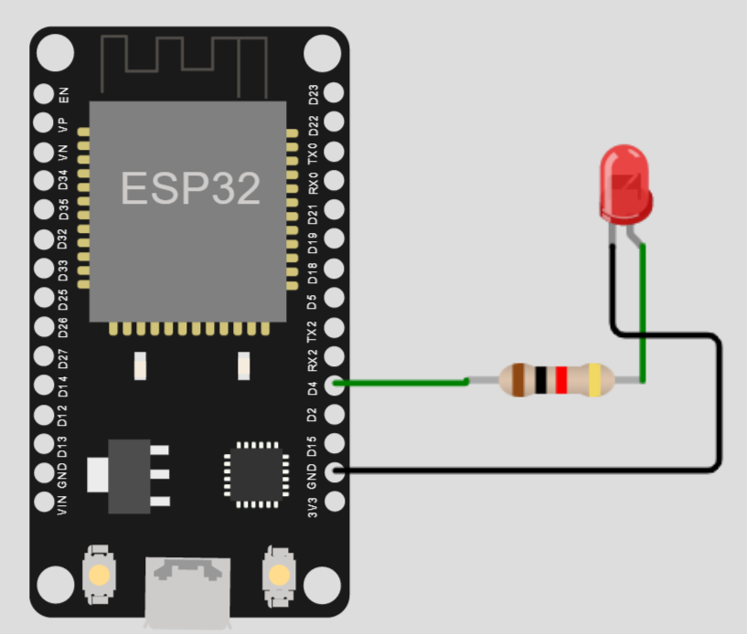
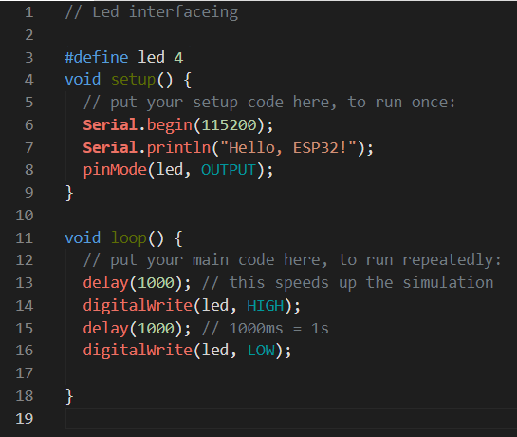
Basic Electronics: Led (Link)
IoT Workshop -1 (Atharva Pawar)

Slide 5
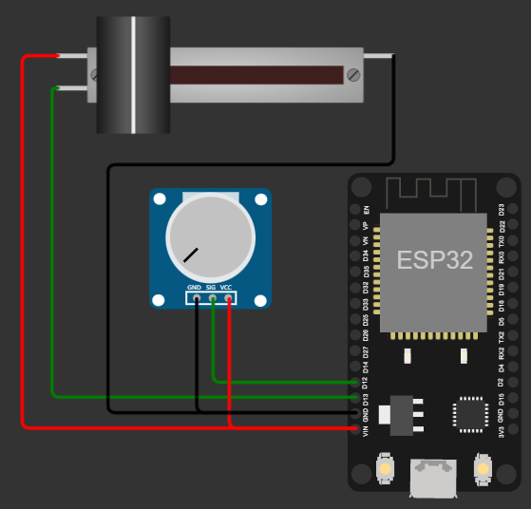
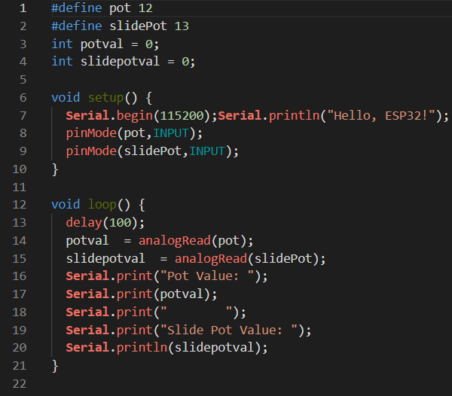
Basic Electronics: Potentiometer (Link)
IoT Workshop -1 (Atharva Pawar)

Slide 6
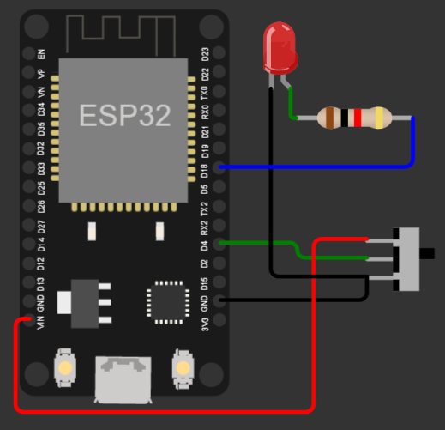
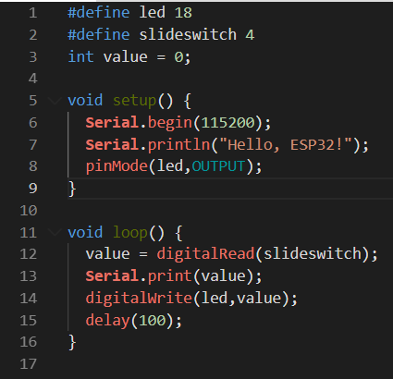
Basic Electronics: Slide Switch (LINK)
IoT Workshop -1 (Atharva Pawar)

Slide 7
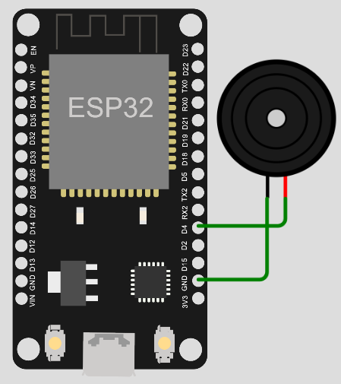
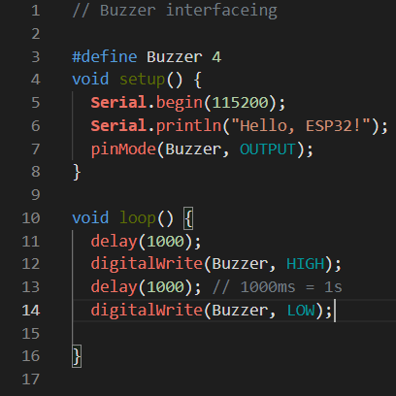
Output Device: Buzzer
IoT Workshop -1 (Atharva Pawar)

Slide 8
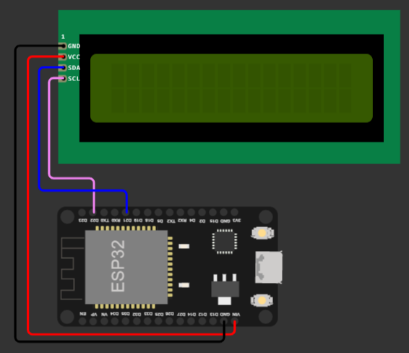
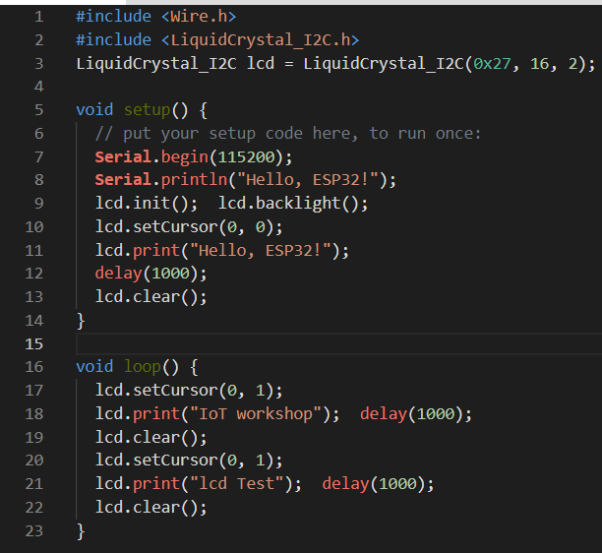
Output Device: I2C 16x2 LCD(Link)
IoT Workshop -1 (Atharva Pawar)

Slide 9
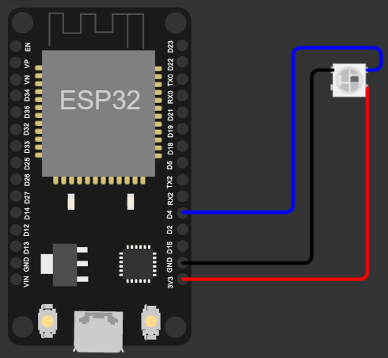
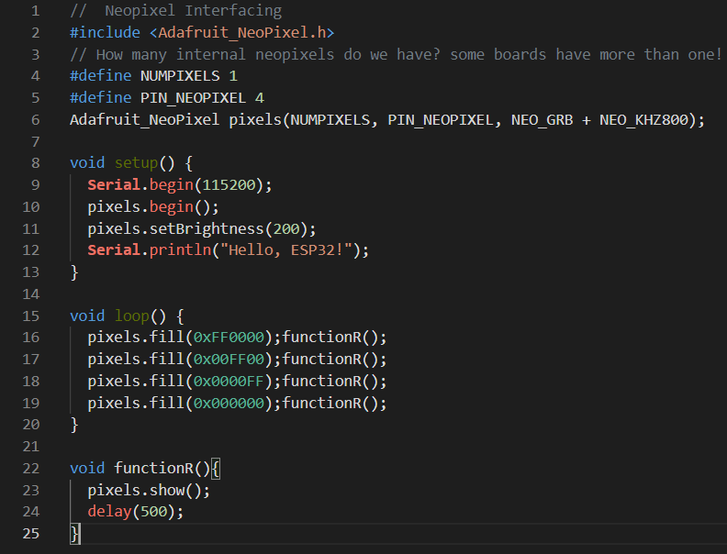
Output Device: Neo Pixel (Link)
IoT Workshop -1 (Atharva Pawar)

Slide 10
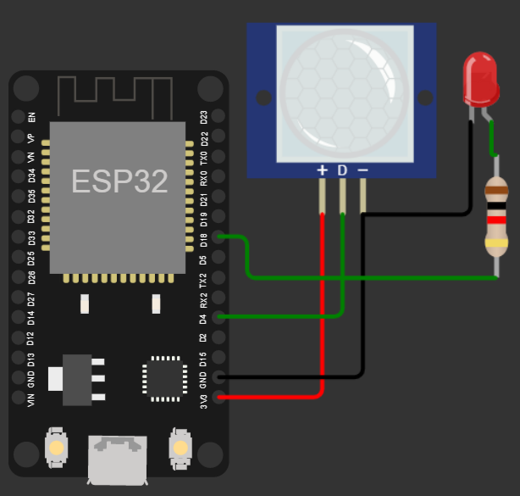
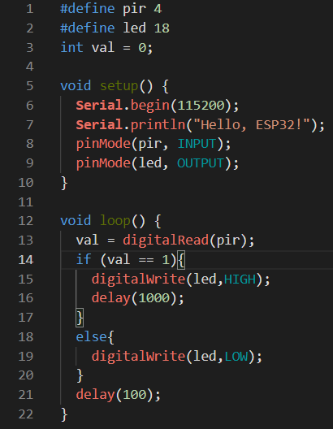
Input Device: PIR(link)
IoT Workshop -1 (Atharva Pawar)

Slide 11
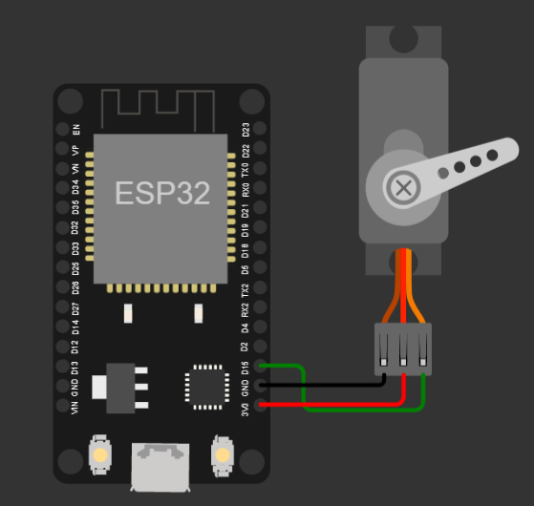
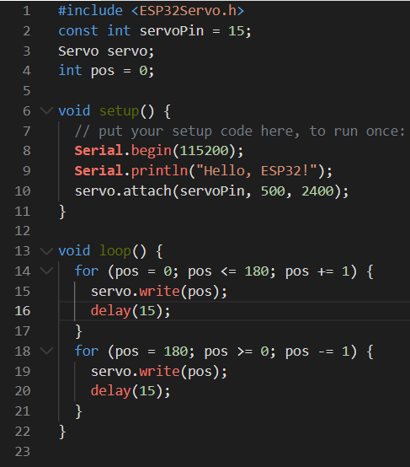
Output Device: Servo(LINK)
IoT Workshop -1 (Atharva Pawar)

Slide 12
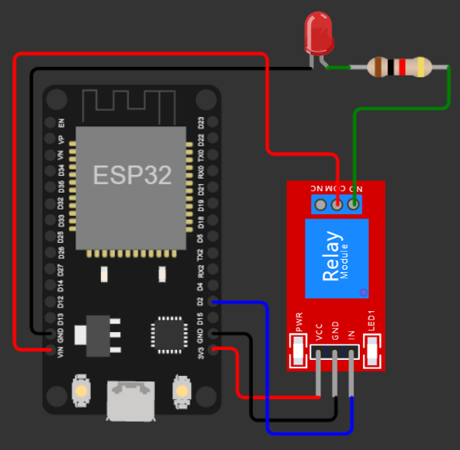
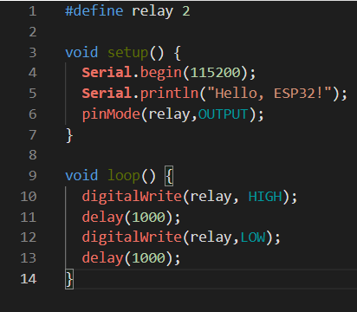
Output Device: Relay(link)
IoT Workshop -1 (Atharva Pawar)

Slide 13
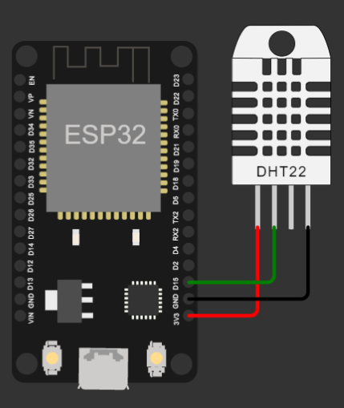
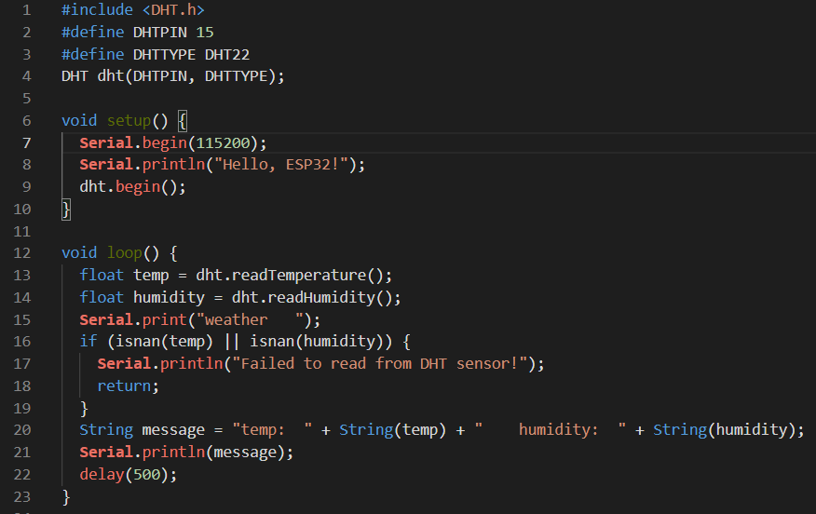
Input Device: DHT22(link)
IoT Workshop -1 (Atharva Pawar)

Slide 14
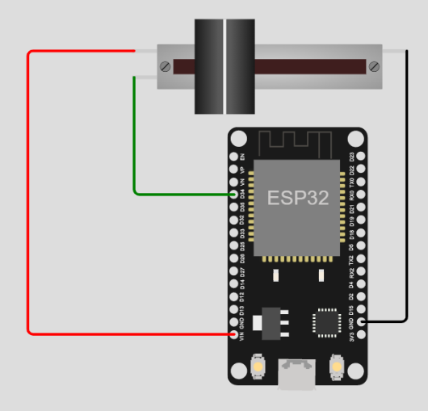
IoT (Read PoT): Thingspeak(dB)(link)
IoT Workshop -1 (Atharva Pawar)

Slide 15
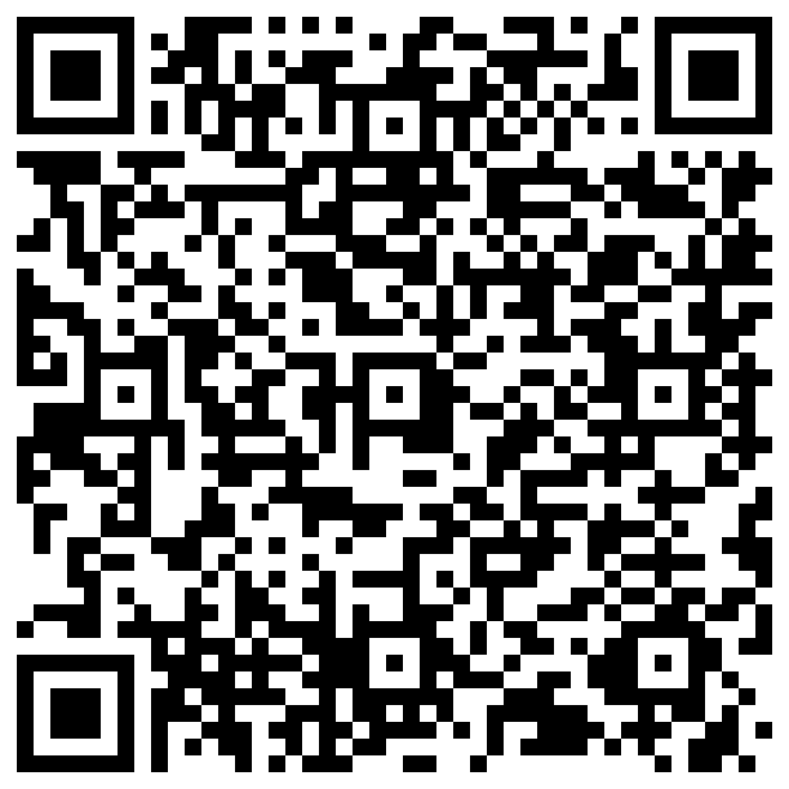
### Links: Led Potentiometer SlideSwitch I2C LCD Buzzer NeoPixcel PIR Servo Relay DHT22 IoT (Read POT) - Thingspeak
PPT Link
IoT Workshop -1 (Atharva Pawar)

